Slide 1
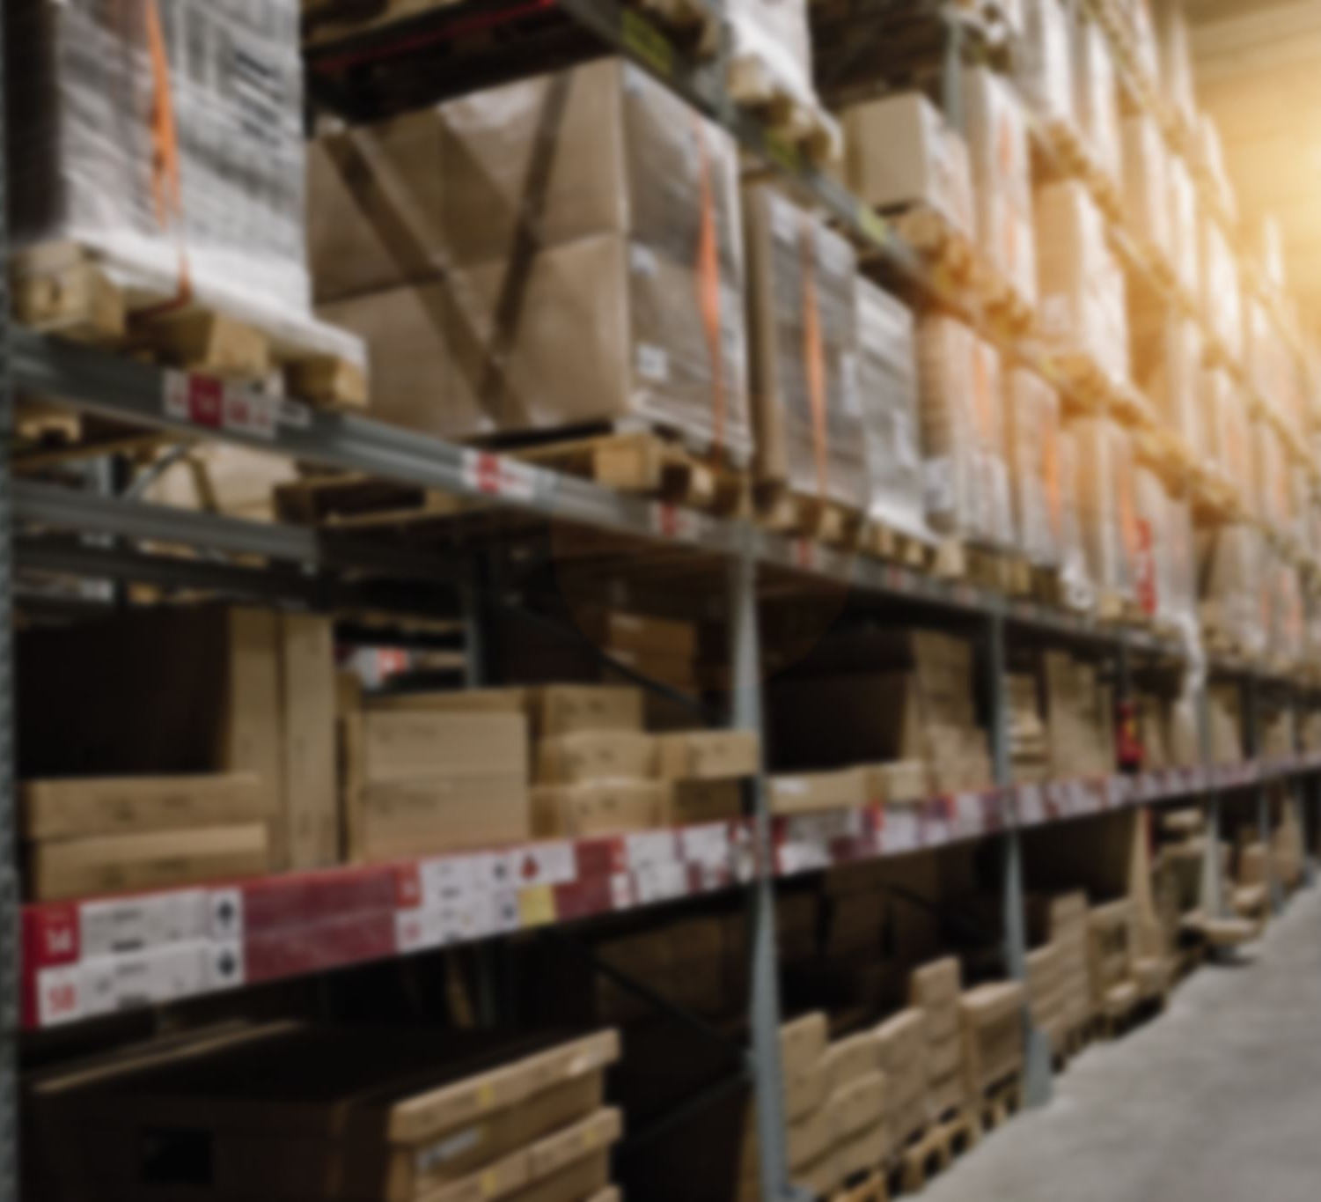


Consumer Goods Ad_Hoc Insights
Code basics

Slide 2
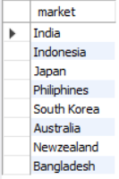
Request 1
Provide the list of markets in which customer "Atliq Exclusive" operates its business in the APAC region.
Output:

Slide 3
Insights for Request 1
The list of markets in which customer "Atliq Exclusive" operates its business in the APAC region are
India,
Indonesia,
Japan,
Philiphines,
South Korea,
Australia,
New zealand,
Bangladesh.

Slide 4

Request 2
What is the percentage of unique product increase in 2021 vs. 2020? The final output contains these fields,
unique_products_2020 unique_products_2021
percentage_chg
Output:

Slide 5
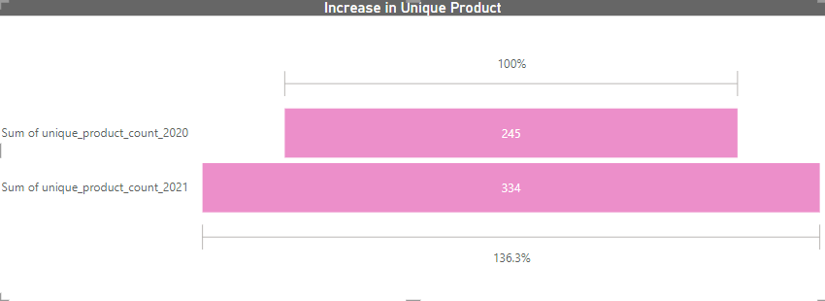
DATA To Visuals

Slide 6
Insights for Request 2
Total Number of unique products in 2020 were 245 products.
Total Number of unique products in 2021 were 344 products.
Which shows that 99 new products have been inculded in the inventory in 2021 and the percentage of rise in unique products is 36.33%.

Slide 7
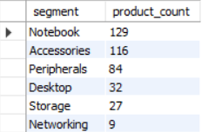
Request 3
Provide a report with all the unique product counts for each segment and sort them in descending order of product counts. The final output contains 2 fields,
Segment, product_count
Output:

Slide 8
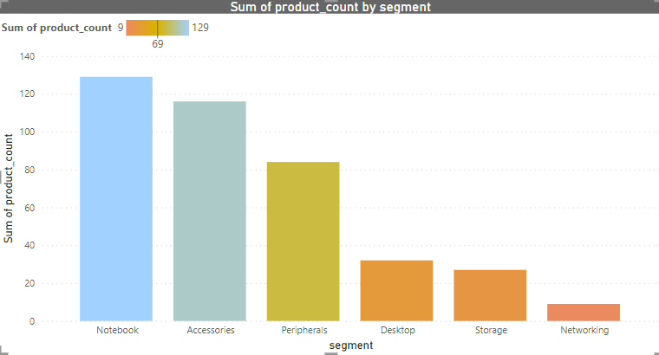
DATA To Visuals

Slide 9
Insights for Request 3
Highest amount of unique products are in Notebook segment with 129 Products .
Lowest amount of unique products are in Networking segment with 9 Products .
Both Notebook, Accessories segments has more than 100 unique products.

Slide 10
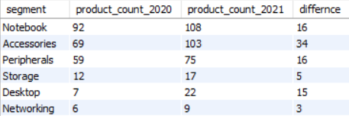
Request 4
Which segment had the most increase in unique products in 2021 vs 2020? The final output contains these fields,
segment
product_count_2020
product_count_2021
difference
Output:

Slide 11
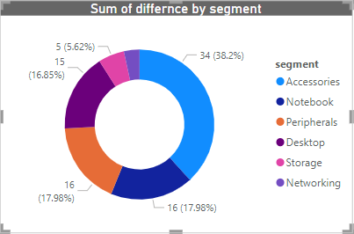
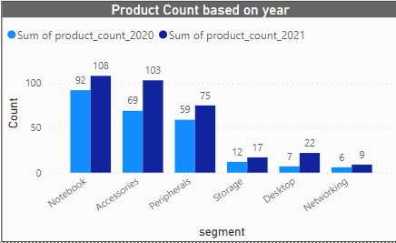
DATA To Visuals

Slide 12
Insights for Request 4
In the fiscal year of 2021 most number of new products has been included in Accessories segment with 34 products which contributes 38.2% in the difference .
In both notebook and peripherals segment's 16 new products have been included in fisca1 year 2021 .
Note :
Both the insights are drawn by comparing with the fiscal year 2020

Slide 13

Request 5
Get the products that have the highest and lowest manufacturing costs. The final output should contain these fields,
product_code
product
manufacturing_cost
Output:

Slide 14
Insights for Request 5
AQ HOME Allin1 Gen 2 (Product code: A6120110206) has highest manufacturing cost of $ 240.54.
AQ Master wired x1Ms (Product code: A2118150101) has lowest manufacturing cost of $ 0.89 .
Note :
By considering the fact that the international currency for trading is dollar $

Slide 15
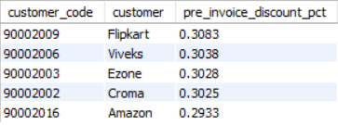
Request 6
Generate a report which contains the top 5 customers who received an average high pre_invoice_discount_pct for the fiscal year 2021 and in the Indian market. The final output contains these fields,
customer_code
customer
average_discount_percentage
Output:

Slide 16
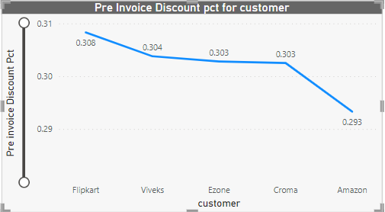
DATA To Visuals

Slide 17
Insights for Request 6
Flipkart has highest average of 0.3803 .
And Followed by
Viveks has average 0.3038,
Ezone has average of 0.3028,
Croma has average 0.3025,
Amazon has average 0.2933.

Slide 18
Request 7
Get the complete report of the Gross sales
amount for the customer “Atliq Exclusive” for
each month. This analysis helps to get an idea of low and high-performing months
and take strategic decisions.
The final report contains these columns:
Month
Year
Gross sales Amount

Slide 19
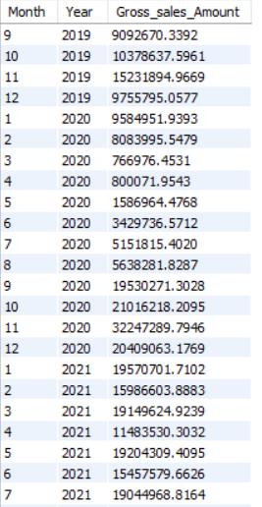
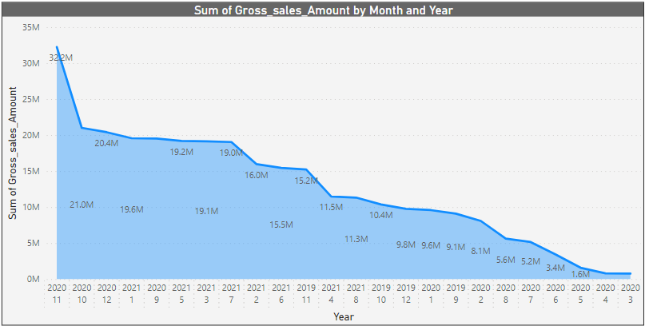
DATA To Visuals

Slide 20
Insights for Request 7
In Year of 2020 in the month of November has recorded 322M which is the highest recorded sales.
In Year of 2020 in the month of March has recorded 0.76M which is the lowest recorded sales.
Note :
Both the insights are drawn for the fiscal year 2020.

Slide 21

Request 8
In which quarter of 2020, got the maximum total_sold_quantity? The final output contains these fields sorted by the total_sold_quantity,
Quarter
Total_sold_quantity
Output:

Slide 22
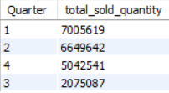
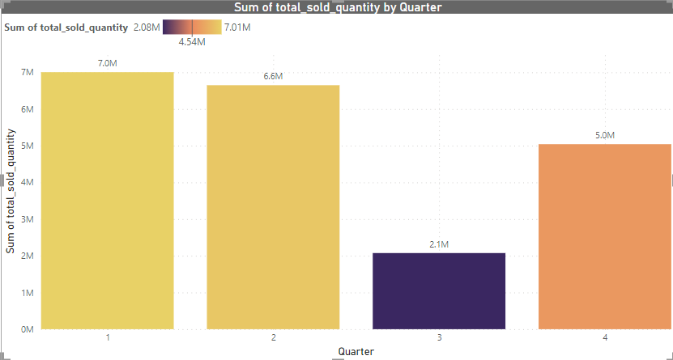
DATA To Visuals

Slide 23
Insights for Request 8
In the First quarter of fiscal Year 2020 maximum quantity has been sold with 7.01M sold quantity.
And in the Third Quarter of the fiscal Year 2020 lowest quantity has been sold with 2.1M sold quantity.
Note :
The fiscal year for Atliq Hardware starts from month of September(09)

Slide 24

Request 9
Which channel helped to bring more gross sales in the fiscal year 2021 and the percentage of contribution? The final output contains these fields,
channel
gross_sales_mln
percentage
Output:

Slide 25
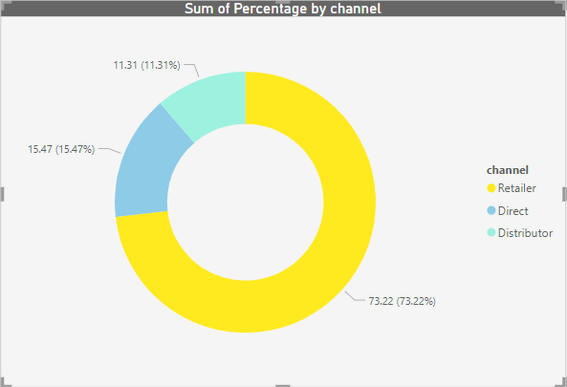
DATA To Visuals

Slide 26
Insights for Request 8
The retailer channel has more gross sales of 73.22%.
And the distributor channel has gross sales of 15.47%
Note :
The contribution of channel has been calculated for the fiscal year of 2021

Slide 27
Request 10
Get the Top 3 products in each division that have a high total_sold_quantity in the fiscal_year 2021? The final output contains these fields
division
product_code
Product
total_sold_quantity
rank_order

Slide 28
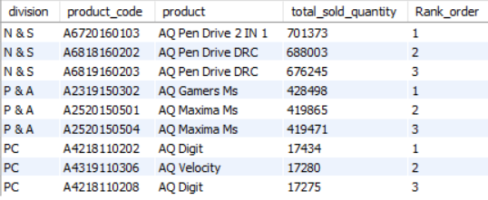
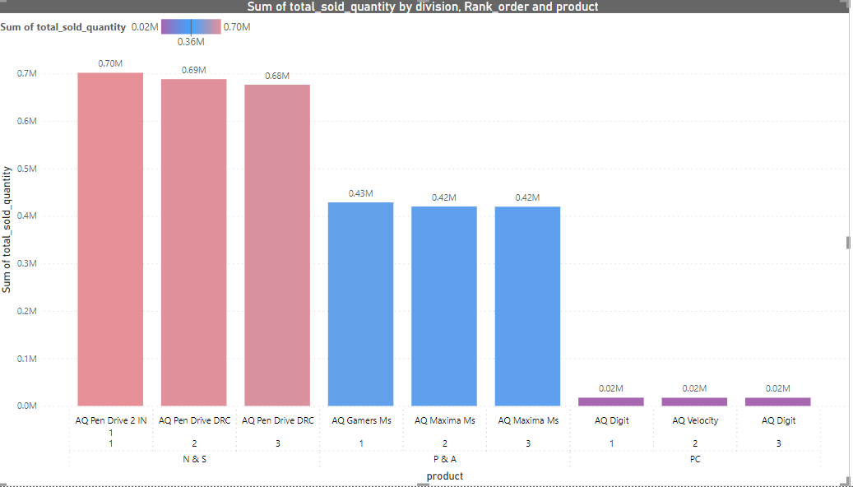
DATA To Visuals

Slide 29
Insights for Request 8
The product in the first rank in N&S is AQ pen drive 2 IN 1In Year of 2021 has recorded 0.70M sold Quantity.
The product in the first rank in P&A is AQ Gamers Ms In Year of 2021 has recorded 0.43M sold Quantity.
The product in the first rank in PC is AQ Digit In Year of 2021 has recorded 0.02M sold Quantity.
Note :
Both the insights are drawn for the fiscal year 2021

Slide 30
Over all insights
The retailer channel has contributed has more contribution in gross sales
The most of sales had occurred in the beginning fiscal year (Sept-Nov).
Notebook and Accessories segments has more Products.
Unique Products is increased at the rate 36.3% in the fiscal year 2021.
Most sold quantity is in N&S division in 2021 fiscal year(Comparing with other division First rank.

